Slide 1
Migration Policy after the 2015 election
Rob McNeil, Madeleine Sumption
and Carlos Vargas-Silva
July 10, 2015

Slide 2
Overview
UK media debate
Skilled non-EU migration and settlement
Net migration target
EU referendum

Slide 3
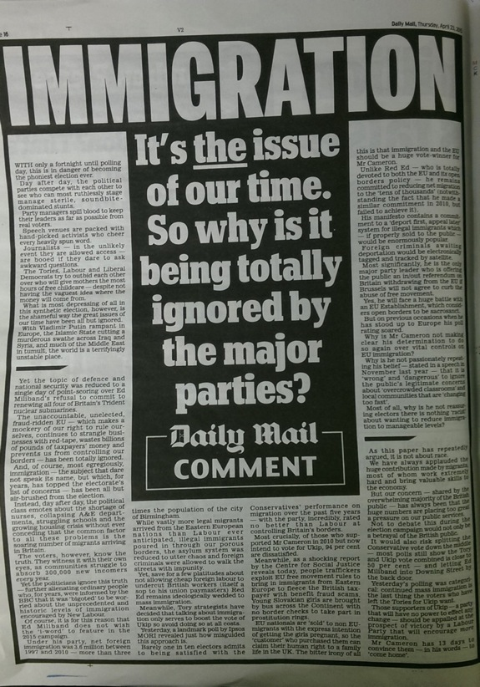
Media and migration: 2015 and beyond
1) the election period
Immigration proved difficult for both main parties and Lib Dems at the election
Reputational risk and concerns of stimulating UKIP support.
Seen by some as “The dog that didn’t bark” at the election.
Notes:
5 minutes for brief introduction

Slide 4
Media and migration: 2015 and beyond
2) The next 5 years – general
Impossible to predict key emerging themes.
Continued commitment to net migration target (/ambition) likely to maintain numerical focus.
New narrative only likely to emerge if a clearer opposition position starts to gain traction.

Slide 5
Which party “has the best policies” on immigration? (Ipsos MORI polls)

Slide 6
Media and migration: 2015 and beyond
3) The next 5 years – non EU
Increased impact of cap on skilled workers and of salary threshold on settlement likely to become more major issues.
Family migration – Supreme court ruling to generate continued discussion. Family migration issues tend to get less media coverage.
Students – continued question of whether they should be a target for reduction
Wars, conflict and chaos in Syria, Ukraine, Libya etc – migration dimension will remain prominent

Slide 7
Media and migration: 2015 and beyond
4) The next 5 years – EU
EU referendum (a referendum on free movement?) and other broad EU immigration issues likely to be highly significant.
Greek drama and impacts can be expected to be seen to have migration dimension for UK.
Calais/Mediterranean situation unlikely to be resolved soon – more tension with France on this?

Slide 8
Tier 2 Cap
Source: Home Office FOI request (April 2011-April 2015) and Home Office website (May 2015)

Slide 9
Prioritising Tier 2 applications
Shortage list
PhD-level position
Salary

Slide 10
Who earns less than £46,000?
Source: Annual Survey of Hours and Earnings, 2014, full-time employee jobs

Slide 11
Tier 2 policy questions
Is salary a good proxy for contribution?
What happens when it isn’t?
  Flexibility for “high value roles, key public service workers,[…] specialist skills”?
  Role of subjective vs. objective criteria
Review of other Tier 2 issues
  Sunsetting shortage list occupations
  Intracompany transfers
  Cap on share of workforce?
  Skills levy
  Work rights for dependants

Slide 12
Tier 2 entry visas issued over time
Source: Immigration Statistics Q1 2015, table vi_04

Slide 13
Settlement policies
£35,000 income threshold for workers from 2016
New class of long-term but temporary jobs?
Impacts related to entry salary thresholds

Slide 14
Settlement grants over time
Source: Immigration Statistics Q1 2015

Slide 15
Should students be taken out of the target?
Central point of discussion during last parliament and likely in this one.
Arguments in favour:
  Public does not consider students to be 'immigrants‘. Less likely to support restrictions.
  Students bring economic benefits.
Argument against:
  Residents (even temporary ones) still contribute to demand for services.
  Not all temporary. Many settle permanently in the UK.

Slide 16
Three points for discussion
  Net migration stats vs target.
  Removing students in practice.
  Consequences for target.

Slide 17
Net migration stats vs target
Net migration stats: based on an internationally recognized definition of people who move for 12 months or more.
Net migration target: policy goal that can be designed in any way the Government sees fit.

Slide 18
  Removing students in practice
In theory: if all students leave, it should make no difference over long-term.
Obvious way: remove students from inflows and remove former students from outflows.
Result: net migration of all people who do not arrive as students.
  Impossible until recently.

Slide 19
Without students

Slide 20
Without non-EU students only

Slide 21
  Consequences for target
Credibility issues? (i.e. changing target of the target)
  Is there a need for a “lower” target after removing students?
  Disconnect between target and population growth.

Slide 22
The EU referendum: key issues that can be explored right now
Numbers and selection
In-work benefits
“Demand-reduction” policies
Brits abroad

Slide 23
Numbers and selection
Who could be expected to qualify for admission if they faced the same rules as non-EU nationals?
Which sectors would be most affected by any changes?

Slide 24
In-work benefits
What are the characteristics of families who are claiming in-work benefits?
What does this tell us about the impacts of proposed residence requirements on future migrants?

Slide 25
“Demand-reduction” policies
What are the expected effects of policies designed to reduce demand for low-wage labour from overseas without changing the UK-EU relationship?

Slide 26
Brits abroad
If EU countries imposed admission restrictions on British citizens in an exit scenario, which groups would be most likely to be affected and how?

